Slide 1

DATASYNTHESIS
Open-Source Synthetic data platform

Slide 2
Agenda
Background
DataSynthesis as a Platform
Real World Usage
DataSynthesis Direction
Reference Materials

Slide 3

Background
Setting the stage
EDIT SLIDE SUBTITLE HERE
Some details and core background

Slide 4
What is Synthetic Data and Why Its
Needed
What it is
How It Can be Used
Synthetic data is a fancy way to say fictitious or “fake” data, the key aspect is the data must resemble the systems it comes from closely
Intended to enable various levels of testing across multiple teams with a consistent set of data closely resembling real-world systems
Integration, implementations, and application development efforts. If there are data needs for existing efforts this platform is a potential fit
Ongoing testing, security and quality assurance practices for most organizations

Slide 5

Healthcare Industry Problem(s)
Application development / Implementations / Integrations of systems require lots of data
Data generation, let alone Industry standards-based data generation, can be a challenge
Randomizing is easy with existing technologies, anonymizing is not
There are lots of potential components available to piece together but nothing consistent or that provides vast capabilities in one place

Slide 6







Project Herophilus Perspective
Rethink data needs: Synthetic Data as a platform
Core mindset: provide massive synthetic data at scale to solve many needs
Look at other industry efforts like Synthea and emulate capabilities with massive data
Enable multiple teams in their needs: development, integration, testing, security, and operations
Multiple implementation model support: on-premise, single public cloud, multi-cloud, or all of the above

Slide 7






Our Focus: Solve Business Challenges
Business innovation
Technical Enablement and Agility
Operational Simplification
Deliver customer centric value
Show data-driven capabilities
Minimize operational challenges
Enable innovation, increase productivity, and offer better data-driven products and services
Provide data with development, including PaaS and SaaS services
Deliver data seamlessly and consistently with insight

Slide 8
DataSynthesis History
2020 (Started in August 2020)
2021
2022
Brought concept to the open-source community
Focused on initial needs and building a data model to accommodate it
Moved from prototypes of data and code into a more formal effort
Moved from a database-only capability to a platform
Enhanced data model based on early adopters' feedback
Built out initial APIs (Quarkus and Node) to support the initial platform
Initial implementations were implemented in IBM cloud and AWS
Grew data tier to support SnowFlake
PostgresQL became the core RDBMS we used
Focused on container deployment, leveraged OpenShift
Added support for complex data structures
Generate data for healthcare industry standards: HL7 and FHIR

Slide 9

DataSynthesis
Platform
The Synthetic Data Platform
Implementation Types and Data Tier

Slide 10
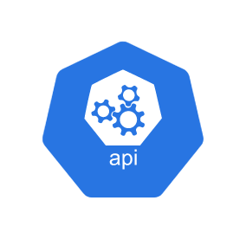
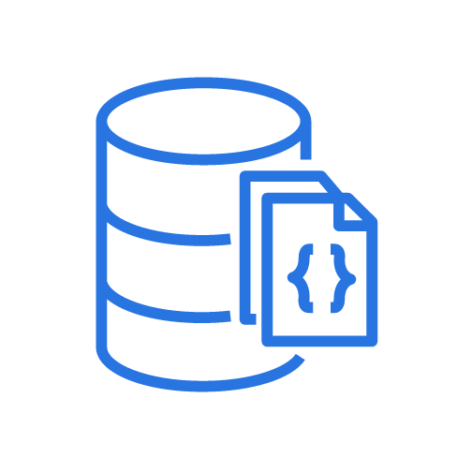
Implementation Types
All code is provided on Git Hub at https://github.com/Project-Herophilus/DataSynthesis
RDBMS scripts and data loaders included
APIs are the core means for access – Quarkus and Node APIs are implemented, Node APIs are most maintained
Minimal Web UI is in place, Vue based
SQL Queries are also included in the repository for common SQL queries
Cloud Native API with Freestanding RDBMS
Container /
Machine Based
Free Standing
RDBMS

Slide 11

Data Tier – Massive Possibilities
The platform is based on the concept of data attributes
Data structures are built from putting together sets of data attributes
Native support for custom terminologies/code used within implementations
Platform supports very simple to highly complex implementations, support for multiple implementations is natively included

Slide 12
Data Tier
Codesets
Countries
DataGenTypes
Industries
IndustryStds
OperationTypes
SensitivityFlags
Status
TerminologyStds
Timezones
Vendors
Area Codes - US
Area Codes - Intl.
Bank Routing Numbers
Names: Last
Names: First
Professions
UPC
Zip Codes US
Zip Code Intl
Reference
Data
AppSettings
DataAttributes
DataStructures
Data Existing
Platform
Data
Terminology
Terminology – Industry Stds.
Terminology – UMLS (MRConso)
Terminologies
Implementations
Application
Codesets
Codeset-Crossmaps
Legal Entities
Organizations
Rulesets
Rulesets - Definitions
Data Model
Data Generated
Data Structures
Account Numbers
Addresses (Street)
Bank Accounts
Credit Cards
Custom
Date of Birth
Devices
Drivers Licenses
EIN (Employer ID Numbers)
Phone Numbers
Social Security Numbers
User Identities
APIs
DataTables
Domain
Addresses
Banking
Demographics
Phone Numbers
Full Names
Business Details
Products

Slide 13
Data Tier - Statistics
These are ONLY initial data counts; anyone can use the generators to grow the data quantities.
Data Attribute | Included Records | Notes
Account Numbers | 15,000 | Generated: built to enable organizations to build accounts based on their formats for testing.
Addresses | 33,109 | Generated: built code to support multiple address formats.
Bank Accounts | 74,997 | Generated: Bank Account numbers compliant with Federal Reserve standards.
Credit Cards | 5,000+ | Generated: based on the top four credit cards (Visa, Mastercard, AMEX and Discover). The code was revised to use an industry algorithm for credit cards.
Date of Birth | 29,999 | Generated: We generate both string and date formatted dates of birth with Age calculated in the generation.
Drivers License Number | 142,000 | Generated: drivers license numbers complaint with all 50 US States
Employer Identification Number | 1,000 | Generated Employer Identification Numbers
Phone Numbers | 74,622 | Generated US Phone Numbers
Social Security Numbers | 78,213 | Generated: SSN Numbers
User Identities | 25,000 | User Identities

Slide 14
Data Tier - Statistics
These are ONLY initial data counts; anyone can use the generators to grow the data quantities.
Data Attribute | Included Records | Notes
Area Code - US | 310 | Publicly available US area codes, the platform also has support for multi country based international area codes as well
Area Code - Intl | 0 | Intended for International Area Codes
Bank Routing Numbers | 10,114 | Data provided by the federal reserve through 2018
Company Names | 947 | SEC Company Name List freely provided
Names: First with Gender | 301,551 | First Names from various public sources There is an API that enables organizations to process their names against the ones provided and extended based on their data
Names: Last | 601,223 | Last Names from various public sources There is an API that enables organizations to process their names against the ones provided and extended based on their data
UPC Product Codes | 46,528 | Public List of Products with UPC Codes
Zip Codes - US | 41,861 | Publicly available Zip Code List
Zip Code - Intl | 0 | International Zip Code List (created for international support. However, no reliable source(s) have been verified)

Slide 15
Data Tier – Data Structure Possibilities
Data Type | Notes | Total Initial Quantity
Person Names | Combining First Names and Last Names | 100 B +
Clinicians or Treating Team (Healthcare) | Person Names Person Addresses Phone Numbers - US User Identities | 1 T+
Person Addresses - US | Combining Addresses * Zip Codes - US | 1 B 386 M
Bank Accounts | Combining Bank Routing and Bank Account Numbers | 740 M
Phone Numbers - US | Combining Area Codes and Phone Numbers | 22 M

Slide 16
Data Tier – Data Structure Possibilities
Data Type | Notes | Total Initial Quantity
Person Demographics | Person Names * Person Addresses * DLN * SSN | 1 T+
Insurance Companies | Code and Value from Customer Data or Created Data Person Addresses Phone Numbers - US Contact Name: Person Names | 1T +
Clinicians or Treating Team (Healthcare) | Person Names Person Addresses Phone Numbers - US User Identities | 1 T+

Slide 17

Real World Usage
How To Use It
EDIT SLIDE SUBTITLE HERE
Implementation focused enabler.

Slide 18

How It is Being Used
Use our Postman Collection to explore the platform’s potential
Device Simulation
Platform Scale demonstrations
Testing
Testing platforms
Development, unit, implementation, and performance testing
Development
Data for areas like application, integration, AI, and chatbot development

Slide 19

Common Use Cases Supported
Generate HL7 v2.x ADT (Orders, Results, etc. – on 2023 pipeline)
Generate FHIR Appointments (more on 2023 pipeline)
Use APIs to generate data for a multitude of the twenty three common data attributes provided
Use APIs to generate data for data structures (Names, Addresses, Demographic Records, etc.)
Connect to DataSynthesis database use complex SQL queries to retrieve data
What we do to help healthcare realize the value of synthetic data

Slide 20
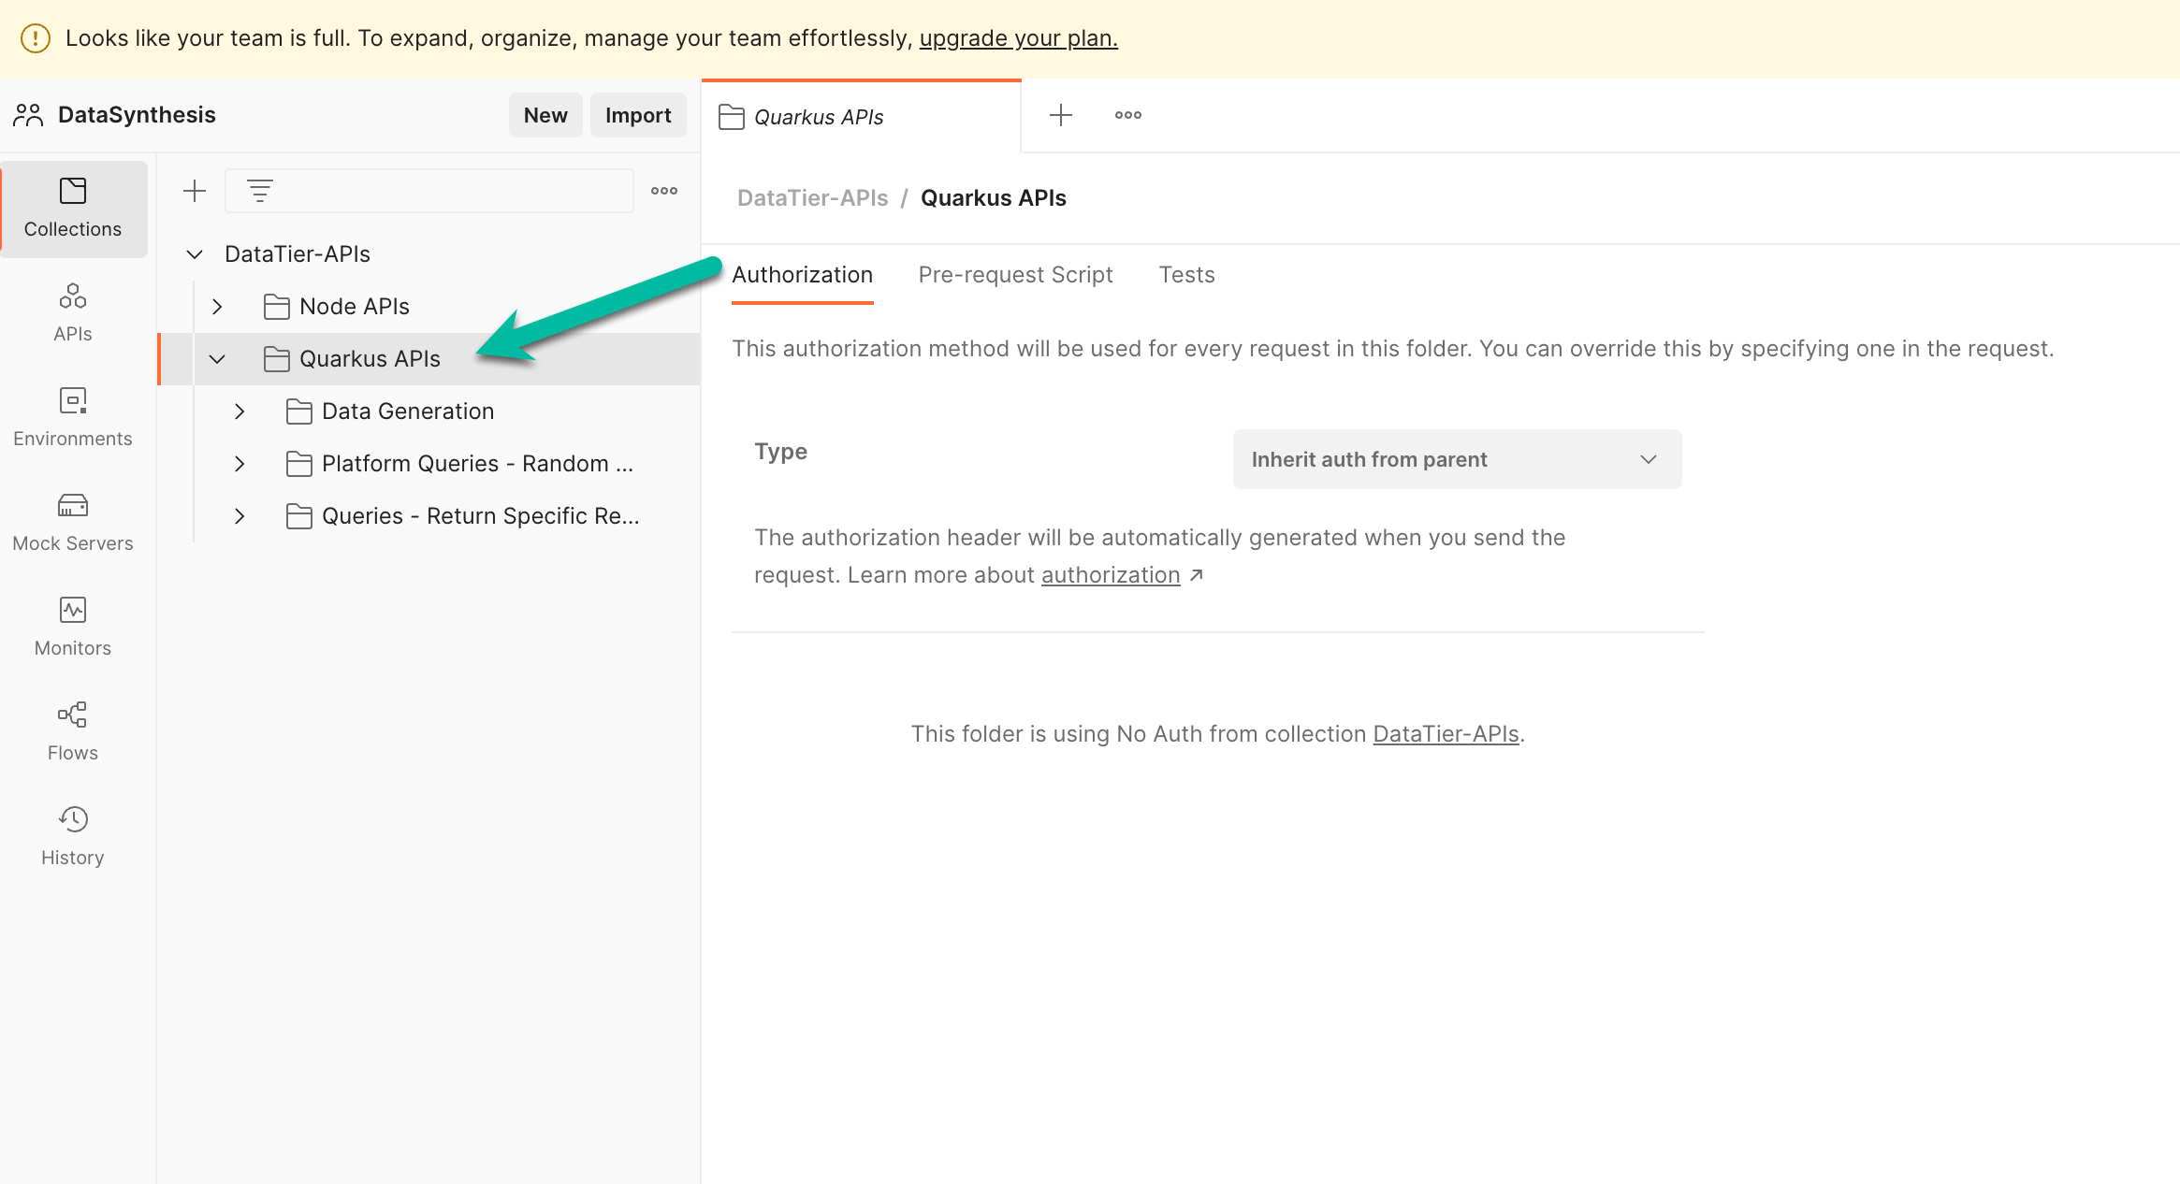
Using APIs: Quarkus
Go the repo and download it https://github.com/Project-Herophilus/DataSynthesis
Setup and implement, then seed your database (if you run the all-in-one container pattern - it puts a small subset of data there).
Go to the DataTier-APIs directory within the project and then to the Quarkus-APIs directory and run this command (all the params are put in based on my implementation): Sample Command: mvn quarkus:dev -Dquarkus.liquibase.migrate-at-start=false -DDATABASE_NAME=datasynthesis -DDATABASE_HOST=127.0.0.1 -DDATABASE_USERNAME=root -DDATABASE_PASSWORD=Developer123 -DDATABASE_PORT=3306 -DskipTests -Dquarkus.hibernate-orm.validate-in-dev-mode=false
Use The Postman link to test quickly: Got to Quarkus APIs folder - Generators and Queries available DataSynthesis Data APIs

Slide 21
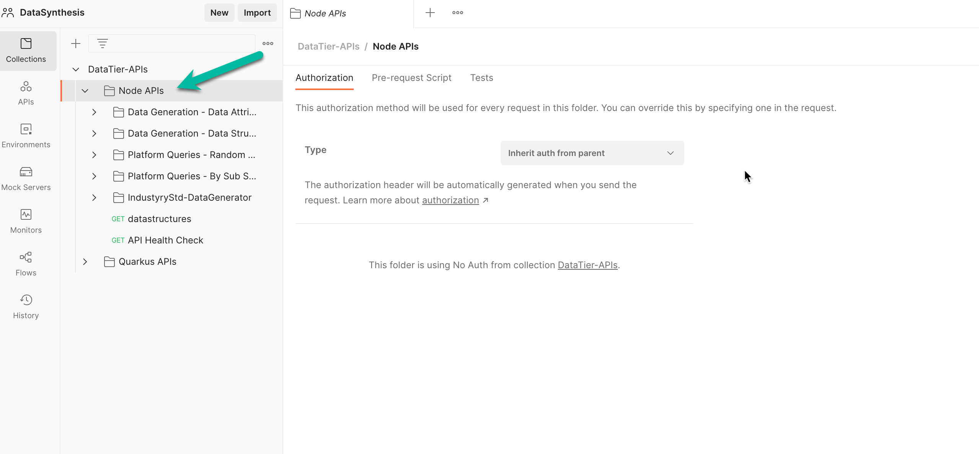
Using APIs: Node
Go the repo and download it https://github.com/Project-Herophilus/DataSynthesis
Setup and implement then seed your database (if you run the all-in-one container pattern - it puts a small subset of data there).
Go to the DataTier-APIs directory within the project and then to the Node-APIs directory and run this command (all the params are put in based on my implementation): To startup, Node APIs require a .env file (or environment variables persisted in some way). Here is a detailed example of how this can be done.
Use The Postman link to test quickly: Got to Node APIs folder DataSynthesis Data APIs

Slide 22

Using Additional Node Assets
Go the repo and download it https://github.com/Project-Herophilus/DataSynthesis
Setup and implement then seed your database (if you run the all in one container pattern - it puts a small subset of data there).
To startup, Node Assets require a .env file (or environment variables persisted in some way). Here is a detailed example of how this can be done.
There are numerous additional specifically developed Node-based assets and they can be used immediately, the details can be found here

Slide 23

DataSynthesis
Direction
Our Future Plans
EDIT SLIDE SUBTITLE HERE
Plans and direction for the future

Slide 24

DataSynthesis Key Direction Tenants
Monthly online meetings
Continue to grow committers and companies leveraging the platform
Improve existing capabilities enabled within the platform
Add new capabilities to extend and enhance the platform, connect with other community assets

Slide 25

DataSynthesis Technical Direction
SQL Server database implementation (in place as of January 14)
Development of Jypter Notebooks for various common tasks
.NET Core and Python technology usage
Azure and GCP-based implementations on matching existing AWS implementation
Public Cloud native PaaS and SaaS integration

Slide 26


Reference Materials
Supporting Content
EDIT SLIDE SUBTITLE HERE
Any related content for this platform can be located here.

Slide 27
Open-Source Links
Upstream intelligent DaaS GitHub Site: https://github.com/Project-Herophilus/
iDaaS Connect: is how iDaaS can process data from potentially from hundreds of available systems, industry standards and data formats. The ability to connect to/from systems is iDaaS Connect, within this one repository there are dozens of defined modules for connecting to data such as Blue Button, HL7, FHIR, EDI, APIs, Kafka, JDBC, FTP/FTP(s), File, SAP, Cloud Vendor(s) and many more included. While it is one repository it has all the iDaaS Connect branded modules within it.
https://github.com/Project-Herophilus/iDaaS-Connect
iDaaS KIC: KIC (Knowledge, Insight and Conformance). This is the place where all auditing, error handling and iDaaS insight occurs. This platform includes both an internal (iDaaS) and an external data processing capability with endpoints available for easy system connectivity.
https://github.com/Project-Herophilus/iDaaS-KIC
DataSynthesis: Open-Source platform for building synthetic/fictitious data for business/healthcare needs. Has over 100B data attributes for immediate usage and contains over 20+ data-specific areas
https://github.com/Project-Herophilus/DataSynthesis
Defianz: Open-Source platform for de-identification and/or anonymization.
https://github.com/Project-Herophilus/Defianz
Data Simulators: Designed and being implemented to help healthcare resources test iDaaS and validate implementations. Included within several of the modules are the ability to “blast” systems with transactions to performance test as well.
https://github.com/Project-Herophilus/DataSimulators
iDaaS DREAM: DREAM (Data Real Time Enterprise Automation). Implementable and extensible data applications built to support business needs. This repository contains assets developed in Java, JavaScript, and Quarkus.
https://github.com/Project-Herophilus/iDaaS-DReAM
Docker Hub:
All projects are being re-tooled to land in Docker Hub with automated CI/CD automation.howing
https://hub.docker.com/search?q=rhhcarch&source=community

Slide 28
THANK YOU
Join our community, and help us make a difference

